Slide 1
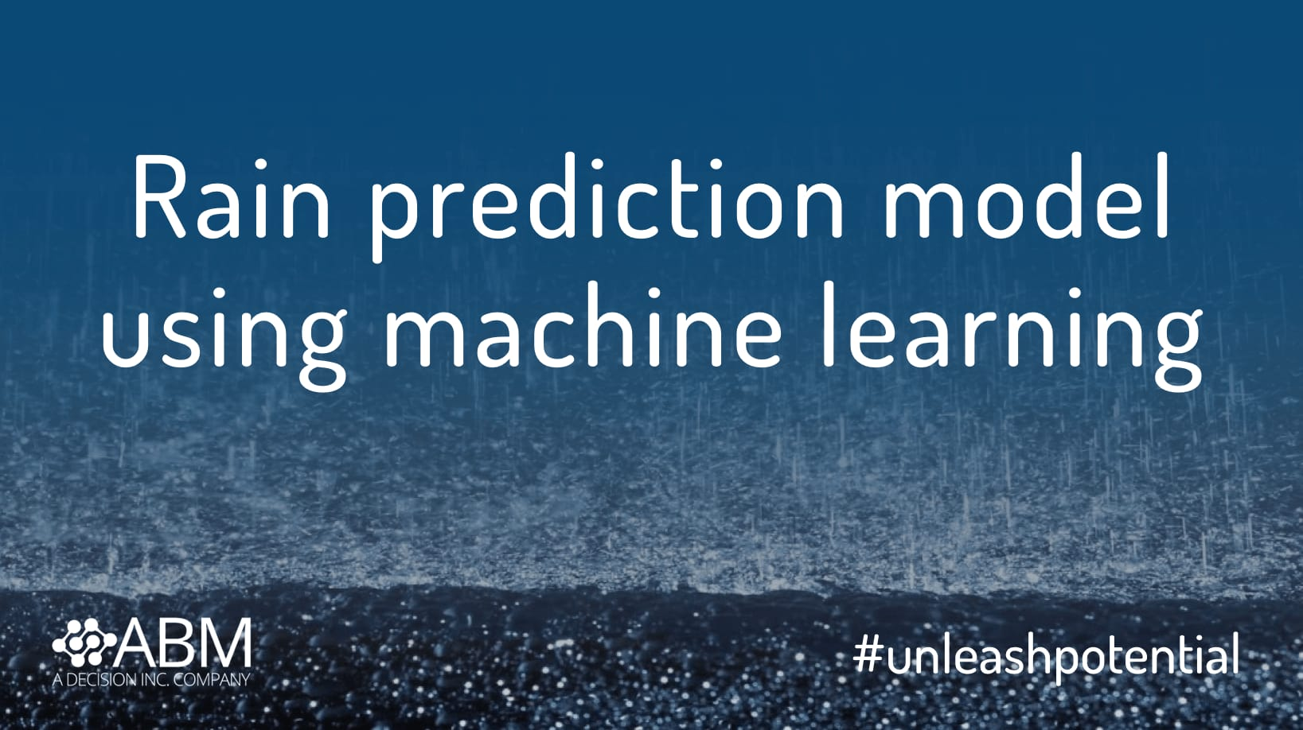
Rainfall prediction using machine learning
Presented by:
Prabhat Dhar
Registration Number:
2108152

Slide 2
Introduction:
Predicting rainfall can assist prevent flooding, save human lives and property. Additionally, it aids in the management of water resources. Prior rainfall data is useful to farmers for improved crop management, which boosts the nation’s economy.
To develop a prediction model for precise rainfall, forecasting is one of the greatest problems for academics from a number of domains, including meteorological data mining, environmental machine learning, functional hydrology.
Here I have used different machine learning technique in order to make rainfall prediction like Random forest method, KNN, Logistic regression, XG Boost Classifier, LDA and Naïve Bayes.
Weather forecasting is the most popular service offered by the meteorological department for all nations worldwide. Due to the need for several specialists and the uncertainty of every calls, the process is quite hard.

Slide 3
Historical Data about the dataset used:
Investigation of weather report in Australia has been done taken into several external factors like humidity, wind speed, wind direction, temperature etc from the year 2008 to 2020 and we will predict whether it is going to rain or not and then forecast amount of rainfall that will occur in next 30 days.
All the necesaary pre-processing steps and cleaning of data has been done before doing the prediction. We has downloaded the dataset from www.kaggle.com and it contains 1,45,460 rows and 23 columns.
Random imputation is used in order to fill the missing value and mean imputation is used for continuous variable which has low percentage of missing value.
Multicollinearity is checked using heatmap and we make the target column balanced as it is not unbalanced at first.
We have also normalize the dataset that is used scaling to keep the value in range(0-1). We have groupby the two columns that is Location and RainTomorrow and used label encoder for our location column according to the target variable.

Slide 4
Algorithms used for machine learning:
Random Forest Method -One of the most used type of ensemble technique in machine learning is random forest method and it has good performance and scalibility that is why it is used in the industry.
Naïve Bayes -In the field of statistics Naive Bayes classifier can be defined as the group of probabilistic classifier which we get after using Bayes Theorem with high independence proof between the features.
KNN–K Nearest Algorithm is a lazy learning algorithm and it is used for regression and classification problem is also a non paramteric model. In machine learning there are two types of models: Parametric and Non Parametric model.

Slide 5
4)Logistic Regression: Classification problems may have binary or multiple outcomes or classes. In our case we will be using binary logistic regression since there are only 2 classes available in the data. Logistic regression is a statistical model in which discrete value is given by response variable and the explanatory variable can be either continuous and discrete Let us assume that outcomes are positive(coded as Y=1) and negative coded as(Y=0).
5)Latent Dirichlet Allocation (LDA), a generative statistical model used in natural language processing, explains a set of observations through unseen groups, with each group explaining why certain portions of the data are similar. An illustration of a topic model is the LDA.
6)XG Boost Classifier: Some model compression strategies allow turning an XGBoost into a single "born-again" decision tree that roughly approximates the same decision function in order to achieve performance and interpretability. Some of the features XG Boost algorithm has that make it different from other algorithm

Slide 6
Results and Discussions:
We use used classification report in order to find the accuracy of the model that we have used like Random Forest Method, Gaussian Naive Bayes, Logistic Regression, K Nearest Neighbors , XG Boost Classifier and LDA . By looking at the accuracy we see that almost all the model perform very well in this data with accuracy around 82-86 percent range. XB Boost performs the best in our case with the accuracy of 86 percent but here we have not used any hyperparameter tuning like in Logistic Regression. The baseline accuracy in case of logistic regression was 83.94 percent and after using the hyparameter tuning with the best parameter value(C=1 and penalty = l2) the accuracy increased to 84.21 percent. The reason why XG Boost has the highest accuracy may be due to A regularised (L1 and L2) objective function with a function of convex loss and a model complexity penalty term is minimised using XGBoost. The training process iteratively continues in order to make the final prediction, and new trees are added that predict the residuals or errors of older 37 trees that are then combined with older trees. This process is known as gradient boosting because, when adding new models, it uses a gradient descent algorithm to minimise the loss. LDA(Latent Dirichlet allocation) also has the accuracy of 84 percent and here also we have used hyperparameter tuning like( solver = ’svd’,’lsqr’,’eigen’) and shrinkage in the range(0,1). Gaussian Naive Bayes has the lowest accuracy because here data is not normally distributed and also the variable are not continuous and we have used lots of data for training and this algorithm don’t work well for all these case. The accuracy of random forest method and K Nearest Neighbor are 85 and 83 percent respectively

Slide 7
Conclusions:
Among all the machine learning techniques that we have used we can see that XG Boost has the best accuracy of 86 percent.
It functions well because it employs several trees, one of which tries to forecast the goal, another some sort of residuals from the first tree, a third the residuals from the second tree, and so on.
Pre-processing operations were carried out on the extracted dataset, including cleaning and normalisation, to increase the precision of classification and prediction.
The future work include that we need to study about various meterogical parameter that is affecting the rainfall prediction because it depends on various parameter.
References:
[Abbot and Marohasy, 2012] Abbot, J. and Marohasy, J. (2012). Application of artificial neural networks to rainfall forecasting in queensland, australia. Advances in Atmospheric Sciences, 29(4):717–730.
[Bengio et al., 2009] Bengio, Y. et al. (2009). Learning deep architectures for ai. Foundations and trends® in Machine Learning, 2(1):1–127.
.

Slide 8


